Slide 1
OpenGL
Khang Lam
Daniel Limas
Kevin Castillo
Juan Battini
3035 - Professor Mark Sargent

Slide 2
What is OpenGL?
Open Graphics Library (OpenGL) is a cross-language, cross-platform application programming interface (API) for rendering 2D and 3D vector graphics.

Slide 3
How is OpenGL used ?
OpenGL is used extensively in the fields of computer-aided design (CAD), virtual reality, scientific visualization, information visualization, flight simulation, and video games.

Slide 4
High Visual Quality and Performance
OpenGL capabilities can be exploited by any visual computing application requiring maximum performance.
Example: 3D animation, CAD, visual simulation.
- Extremely used in markets such as broadcasting, CAD/CAM/CAE, entertainment, medical imaging, and virtual reality.

Slide 5
Examples of some simple programs using OpenGL

Slide 6
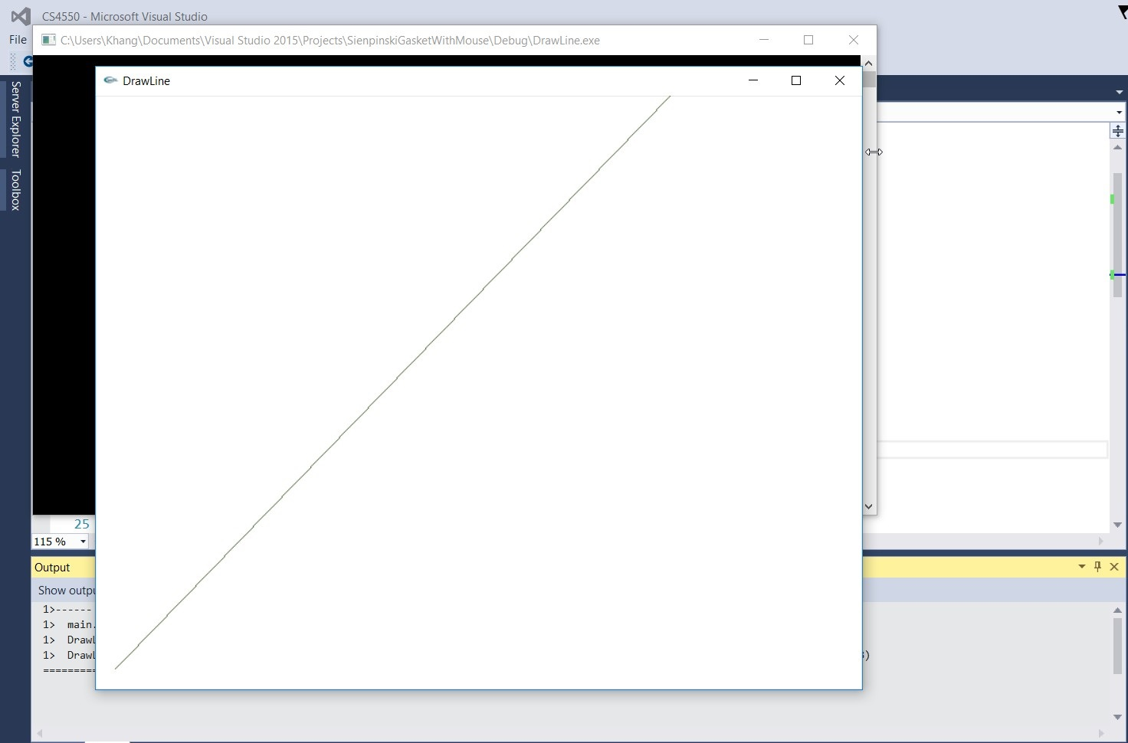

Slide 7
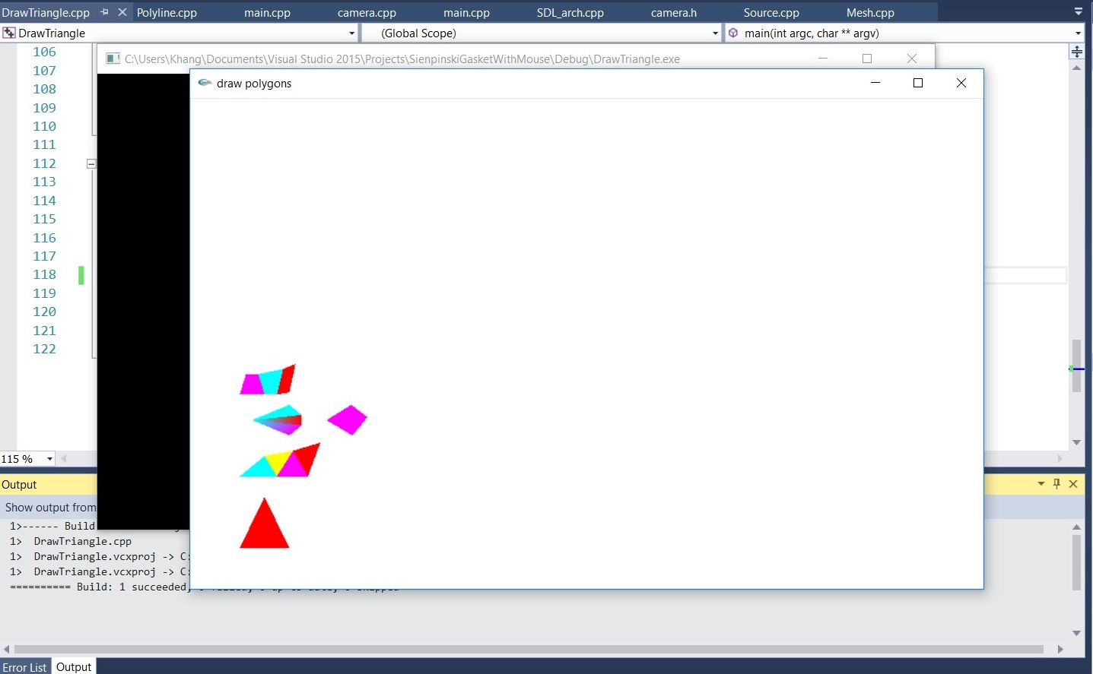

Slide 8
Drawing a Dinosaur
Can use regular libraries and functions that come with the parent language.
Read from file to draw over 300 points to make the drawing of the dinosaur.

Slide 9
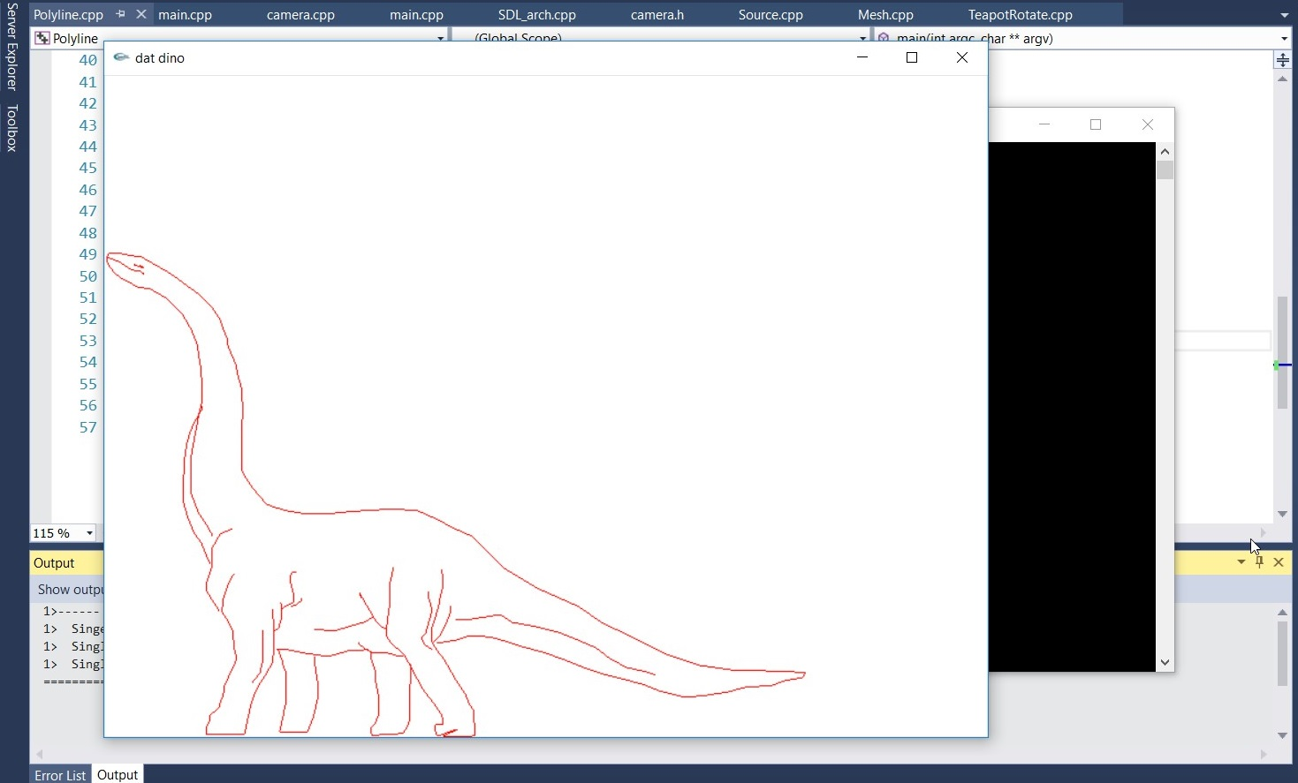

Slide 10
Making a TeaPot
One possible difficulty of this application is that it requires previous knowledge of linear algebra like matrices.
Rotating a TeaPot requires to constantly redraw a teapot at different points on the screen to give the illusion of rotation.

Slide 11
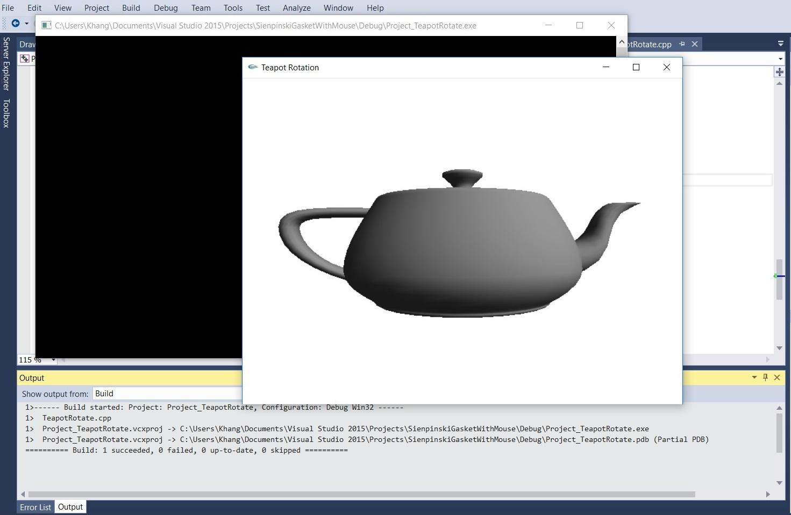

Slide 12
Adding camera Movement
OpenGL has many useful functions that can meet anyones needs.
Has a camera class to allow the user to move around in his masterpiece.

Slide 13
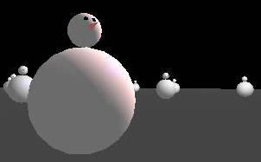

Slide 14
Advantages of using OpenGL
Why is OpenGL widely used ?

Slide 15
Industry standard
OpenGL is the only truly open, vendor-neutral, multi-platform graphics standard.
Broad industry support: an independent consortium, the OpenGL Architecture Review Board, guides the OpenGL specification.

Slide 16
Stable
Available for more than seven years on a wide variety of platforms.
Specifications are well controlled
Proposed updates are announced in time for developers to adopt changes.
Backward compatibility requirements ensure that existing applications do not become obsolete.

Slide 17
Reliable and portable
Produce consistent visual display results on any OpenGL API-compliant hardware, regardless of operating system or windowing system

Slide 18
Evolving
OpenGL allows new hardware innovations to be accessible through the API via the OpenGL extension mechanism.
Allows application developers and hardware vendors to incorporate new features into their normal product release cycles.

Slide 19
Scalable
OpenGL can run on various kinds of systems: mobile devices, PCs, workstations, and supercomputers.
Applications can scale to any class of machine that the developer chooses to target.

Slide 20
Easy to use
OpenGL is well structured with intuitive design and logical commands.
Applications can be written in fewer lines of code compared to other graphic libraries.
OpenGL drivers encapsulate information about the underlying hardware, freeing the application developer from having to design for specific hardware features.

Slide 21
Well-documented
Numerous books about OpenGL have been published
Sample code is readily available

Slide 22
How
OpenGL Simplifies Software Development, Speeds Time-to-Market ?

Slide 23
1.
OpenGL routines simplify the development of graphics software—from rendering a simple geometric point, line, or filled polygon to the creation of the most complex lighted and texture-mapped NURBS curved surface.

Slide 24
2.
OpenGL gives software developers access to geometric and image primitives, display lists, modeling transformations, lighting and texturing, anti-aliasing, blending, and many other features.

Slide 25
3.
Every conforming OpenGL implementation includes the full complement of OpenGL functions.
Language bindings: C, C++, Fortran, Ada, Java.
OpenGL implementations come from a single specification and language binding document
Maximize programmer productivity and shorter time-to-market.

Slide 26
4.
All elements of the OpenGL state can be obtained by an OpenGL application.
OpenGL supports visualization applications with 2D images treated as types of primitives that can be manipulated just like 3D geometric objects.

Slide 27
OpenGL Is Available Everywhere
OpenGL:
Supports UNIX® workstations, Windows 95/98/2000/NT and MacOS PC
Runs on operating systems: Mac OS, OS/2, UNIX, Windows 95/98, Windows 2000, Windows NT, Linux, OPENStep, and BeOS
Works with windowing system: Win32, MacOS, Presentation Manager, and X-Window System.
Callable from Ada, C, C++, Fortran, Python, Perl and Java and offers complete independence from network protocols and topologies.

Slide 28
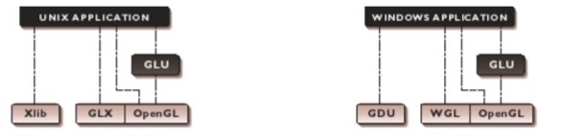
API Hierarchy
OpenGL applications use the window system’s window, input, and event mechanism
GLU supports quadrics, NURBS, complex polygons, matrix utilities, and more

Slide 29
Flexibility and Differentiation
OpenGL hardware acceleration is widely available on everything from low-cost PCs to high-end workstations and supercomputers.
Application developers are assured consistent display results regardless of the platform implementation.
Hardware developers can differentiate their products by developing extensions that allow software developers to access additional performance and technological innovations.
Many OpenGL extensions, as well as extensions to related APIs like GLU, GLX, and WGL, have been defined by vendors and groups of vendors.

Slide 30
Continued Innovation
Formal revisions occur at periodic intervals, and extensions.
Allowing application developers to access the latest hardware advances through OpenGL are continuously being developed.
OpenGL extensions become widely accepted allowing OpenGL to evolve in a controlled yet innovative manner.

Slide 31
Thank you for listening!

